Slide 1
Applied Data science Capstone Project
BY : Chander Bijlani

Slide 2
AgendA
INTRODUCTION
DATA
METHODOLOGY
VISUALIZATIONS
RESULTS AND DISCUSSION
CONCLUSION

Slide 3
Introduction
Problem Description:
Delhi, the capital of india is known for its food culture and rich lifestyle. It is influenced by the food habits of its residents and is where mughlai cuisine originated. It includes a variety of international cuisines which are popular among the residents along with indian
cuisine.
So the aim of this project is to find a suitable location in delhi for a person who is looking to open his restaurant so that it gets people attention and can earn good profit to survive this competitive market andalso for food delivering companies to look for popular food restaurants.
Background Discussion:
Delhi ranks 62 in list of world’s best cities. The dearth of food habits among the delhi's residents created a unique style of cooking which became popular throughout the world, with dishes such as kebab, biryani, tandoori. The city's classic dishes include butter chicken, dal makhani, shahi paneer, aloo chaat, chaat, dahi bhalla, kachori, gol gappe, samosa, chole bhature, chole kulche, gulab jamun, jalebi and lassi.

Slide 4
Stakeholders/Target Audience
This detailed analysis can be used by a person to find the food hotspots in delhi for opening his/her
restaurants or by food delivering companies to look for popular food restaurants.

Slide 5
Data
Data is the foundation of data science;
it is the material on which all the analyses are based.

Slide 6
Data Sources
Delhi Neighborhoods dataset from kaGgle :
This dataset contains information about neighborhoods in the
delhi such as their name, borough, location, etc.
2. Creating a location dataset using foursquare api which will give us the most common venues to establish/open our restaurant.
3. Using Folium library to create interactive visualization maps of
popular or most common venues.

Slide 7
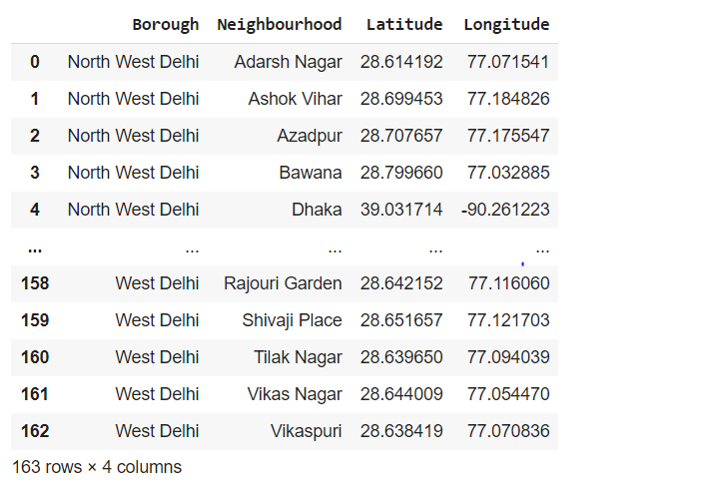
Data Cleaning and pre-pRocesSing
After performing this stage, we got our cleaned data frame:

Slide 8
Methodology
Methodology section is composed of two parts:
Exploratory Data Analysis: Visualize the neighbourhood data of Delhi using location latitude and location longitude and after normalizing the data, we explored the 10 most common venues for setting up restaurant.
Modelling: Helping stakeholders find the right neighborhood within a borough we will be clustering similar neighborhoods using KMeans clustering which is a form of unsupervised machine learning algorithm that clusters data based on predefined cluster size. We will use KMeans clustering to address this problem so as to group data based on existing venues which will helpin the decision making process.

Slide 9
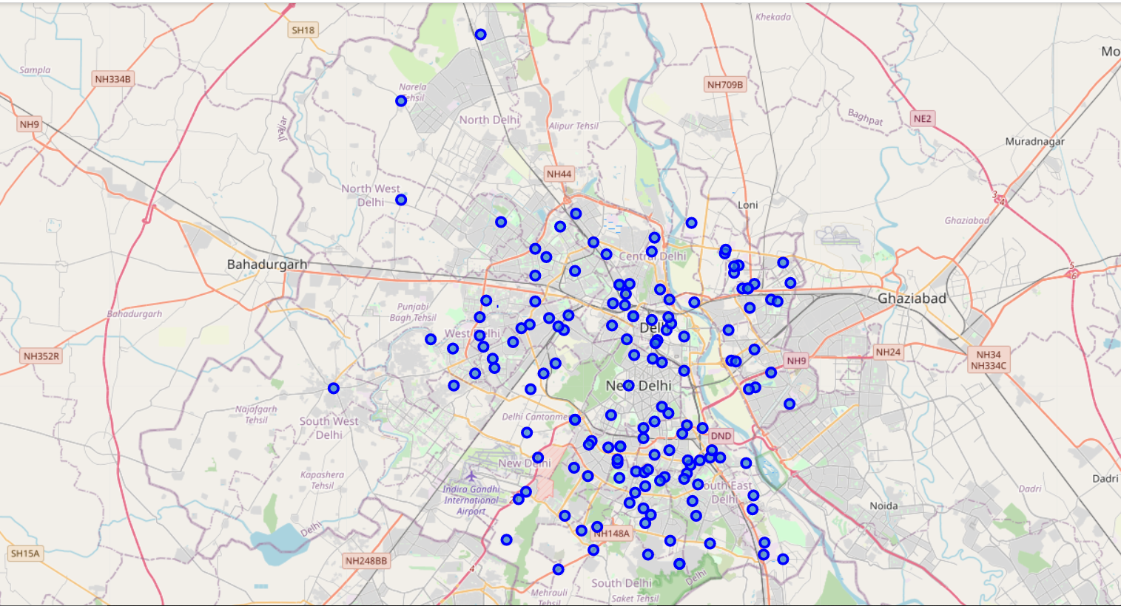
Visualizations
Delhi map using latitude and longitude

Slide 10
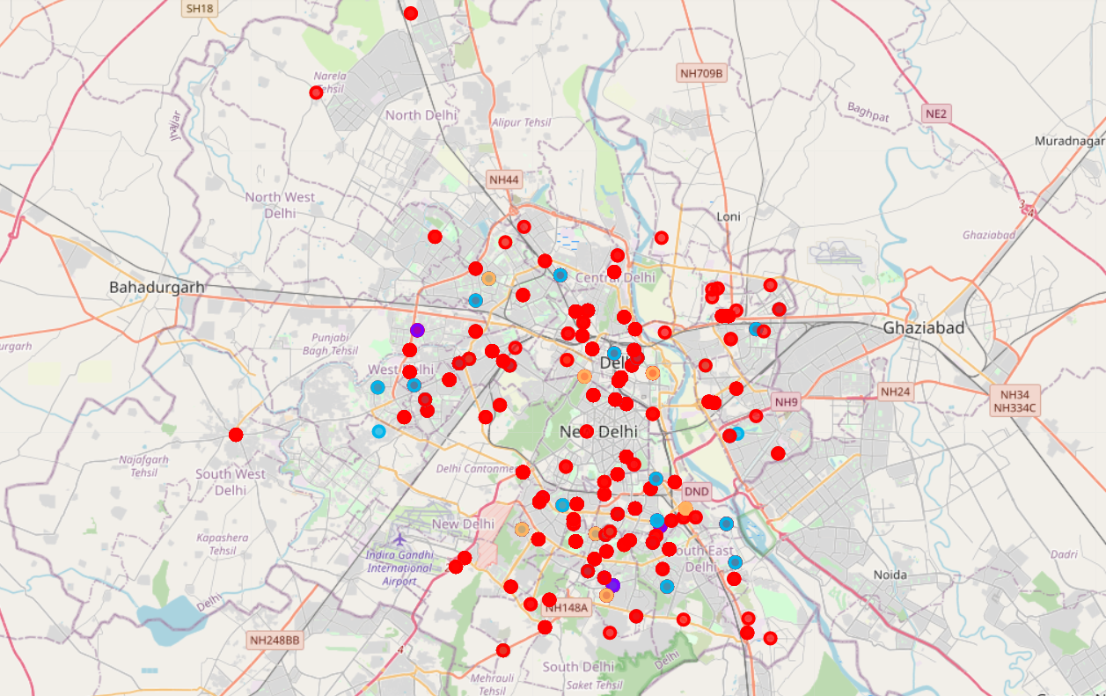
Clustered neighbourhoods on the basis of most common venues in delhi

Slide 11
Results and discussion
The objective of this business problem was to identify a suitable location for the stakeholders to open a restaurant where they can gain huge profit and can survive the market. Here in the analysis, we found the 10 most common venues in neighbourhood in Delhi and with the help of KMeans clustering algorithm we made neighbourhood clusters of Delhi and visualized in the form of iteractive map to show us this venues and in a way helping the stakeholders to find a good place to set up their restaurant.

Slide 12
Conclusion
Through the analysis of neighbourhood data of delhi we found out the 100 top venues of neighbourhoods and after normalizing our data we found the 10 most common venues that are good and profitable for opening a restaurant.

